Slide 1


ALZHEIMER'S DISEASE PREDICTION
USING CROW SEARCH ALGORITHM (CSA)
Optimizing Machine Learning Models for Early Detection of Alzheimer's Disease Using MRI Scans

Slide 2

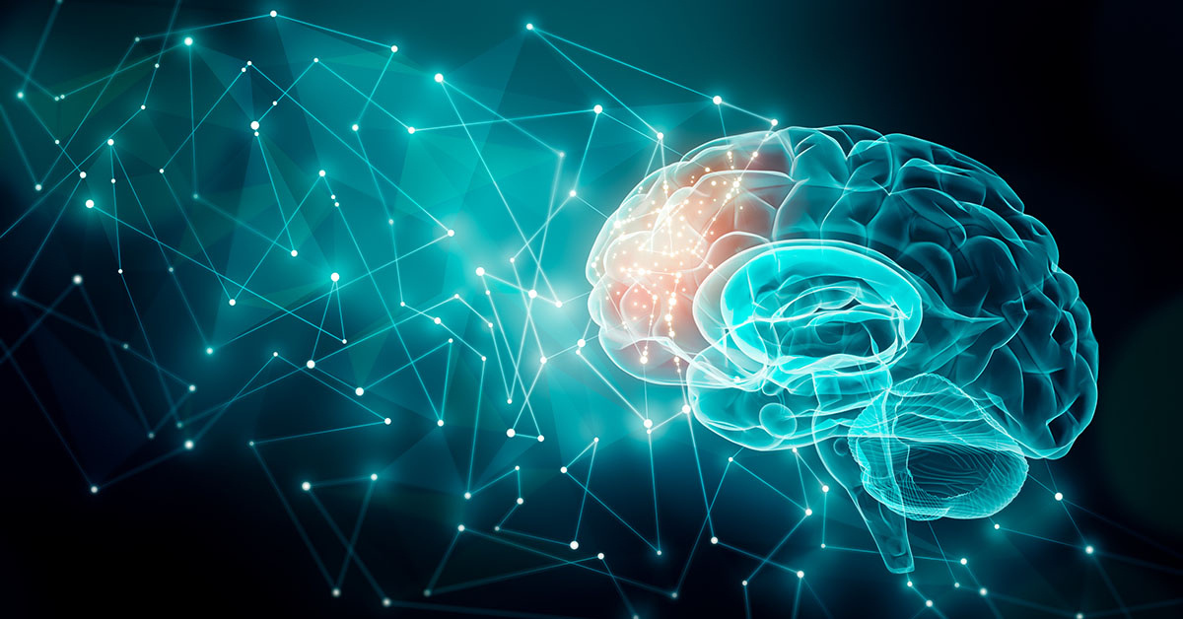
PROBLEM STATEMENT:
Early detection of Alzheimer's disease is critical for managing and slowing its progression. However, traditional diagnostic methods are time-consuming, prone to human error, and require significant expertise.
OBJECTIVE:
To develop a machine learning model optimized with the Crow Search Algorithm (CSA) for accurate prediction of Alzheimer's disease stages based on MRI scans.

Slide 3
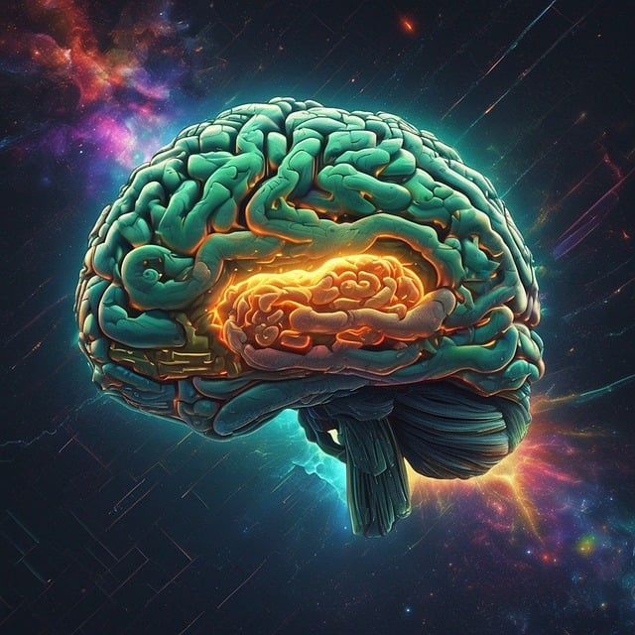
ABSTRACT
This project utilizes MRI scans and machine learning techniques optimized by the Crow Search Algorithm (CSA) to predict Alzheimer's disease stages.
By analyzing MRI images categorized into four stages
Non-Demented
Very Mild Dementia
Mild Dementia
Moderate Dementia
the system aims to improve diagnostic accuracy and efficiency.
The CSA optimizes the model by selecting the best features for classification, resulting in a robust and efficient prediction system.

Slide 4


EXISTING METHODOLOGY
Challenges in Existing Methods:
Traditional machine learning approaches often fail to achieve high accuracy due to non-optimized feature selection.
Manual analysis of MRI scans can be subjective and inconsistent.
Most existing systems lack a bio-inspired optimization approach like CSA, which can improve prediction reliability.
Examples of Existing Approaches:
Generic machine learning models like Support Vector Machines (SVM) or Random Forest.
Deep learning models trained on MRI scans without optimization.

Slide 5


PROPOSED
METHODOLOGY
Image Preprocessing:
MRI scans are preprocessed to enhance quality and extract meaningful features.
Feature Extraction:
Key features from MRI images are extracted for analysis.
Crow Search Algorithm (CSA):
A bio-inspired optimization algorithm mimicking the intelligent behavior of crows.
Selects the most relevant features to improve model performance.
Machine Learning Model:
Optimized using CSA for predicting dementia stages

Slide 6
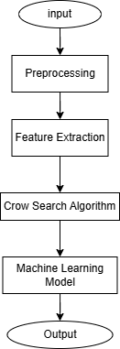
PROPOSED
ARCHITECTURE
Input: MRI scans categorized into dementia stages.
Preprocessing:
Image normalization
Noise removal
Feature Extraction: Using image processing techniques.
Crow Search Algorithm (CSA): Optimizes feature selection for better classification.
Machine Learning Model: Trains on the optimized dataset to predict dementia stages.
Output: Prediction of Alzheimer's disease stage and likelihood.

Slide 7


SOFTWARE
REQUIREMENTS
Programming Language: Python
Libraries: Scikit-learn, TensorFlow/PyTorch, OpenCV
Tools: Jupyter Notebook, Kaggle API
Dataset: Images from Kaggle’s OASIS dataset

Slide 8

REFERENCES
1. Crow Search Algorithm Research Paper:
Crow Search Algorithm: Theory, Recent Advances, and Applications (IEEE) 【16】
2. MRI Scans and Alzheimer's Disease Detection:
MRI-Based Alzheimer's Disease Detection Using Machine Learning (Springer)
3. Dataset Source:
Kaggle OASIS Dataset: MRI Images for Alzheimer's Research

Slide 9

THANK YOU

